Slide 1
3D Computer Vision
Dr. Hassan Foroosh
School of EECS
UCF

Slide 2

Background
La reproduction interdite (Reproduction Prohibited), 1937, René Magritte.

Slide 3



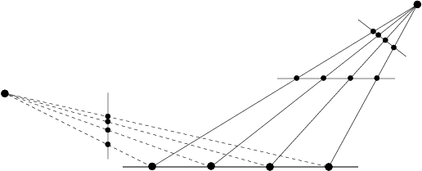
2D Projective Geometry
Representations of Points, lines & conics
Transformations & invariants
Projective geometry and
the Cross-ratio

Slide 4










Homogeneous coordinates
Homogeneous representation of lines
equivalence class of vectors, any vector is representative
Set of all equivalence classes in R³−(0,0,0)^{T} forms P²
Homogeneous representation of points
on
if and only if
The point x lies on the line l if and only if x^{T}l=l^{T}x=0
Homogeneous coordinates
but only 2DOF
Inhomogeneous coordinates

Slide 5
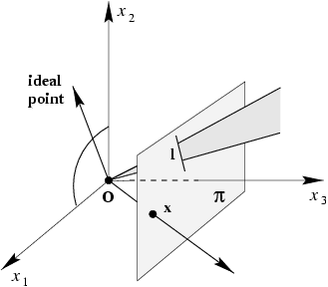
A model for the projective plane
Always one line through two points
Always one point at the intersection of two lines

Slide 6
Geometric Intuition
Why do we need homogeneous coordinates?
  represent points at infinity, homographies, perspective projection, multi-view relationships
What is the geometric intuition?
  a point in the image is a ray in projective space
y
(sx,sy,s)
(x,y,1)
(0,0,0)
z
x
image plane
  Each point (x,y) on the plane is represented by a ray (sx,sy,s)
    all points on the ray are equivalent: (x, y, 1) ≅ (sx, sy, s)

Slide 7
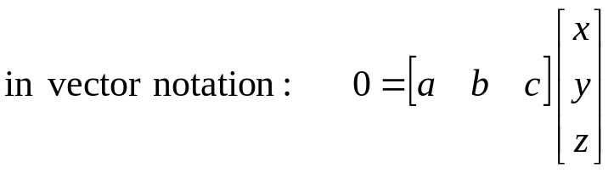
Projective Lines
What is a line in projective space?
  A line is a plane of rays through origin
    all rays (x,y,z) satisfying: ax + by + cz = 0
T
l
p
  A line is also represented as a homogeneous 3-vector l

Slide 8







Points from lines and vice-versa
Intersections of lines
The intersection of two lines and is
Line joining two points
The line through two points and is
Example

Slide 9
Point and Line Duality
  A line l is a homogeneous 3-vector (a ray)
  It is ⊥ to every point (ray) p on the line: l p=0
T
p₁
l₁
p
l
p₂
l₂
  What is the line l spanned by rays p₁ and p₂ ?
    l is ⊥ to p₁ and p₂ ⇒ l = p₁ × p₂
    l is the plane normal
  What is the intersection of two lines l₁ and l₂ ?
    p is ⊥ to l₁ and l₂ ⇒ p = l₁ × l₂
  Points and lines are dual in projective space
    every property of points also applies to lines

Slide 10





Duality
Duality principle:
To any theorem of 2-dimensional projective geometry there corresponds a dual theorem, which may be derived by interchanging the role of points and lines in the original theorem

Slide 11








Ideal points and the line at infinity
Intersections of parallel lines
Example
tangent vector
normal direction
Ideal points
Line at infinity
2
2
R is embeded in P
Note that in P² there is no distinction between ideal points and others

Slide 12
Ideal points: geometric intuition
y
(sx,sy,0)
(sx,sy,0)
y
z
Plane P²
x
z
x
Plane P²
Ideal point (“point at infinity”)
  p ≅ (x, y, 0) – a ray parallel to the projective plane
  It has infinite image coordinates
Ideal line
  l ≅ (0, 0, 1) – a plane parallel to the projective plane
  Corresponds to a line in the P2

Slide 13

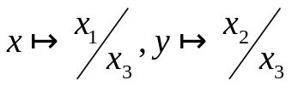
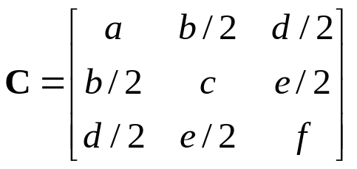


Conics
Curve described by 2nd-degree equation in the plane
or homogenized
or in matrix form
with
5DOF:

Slide 14



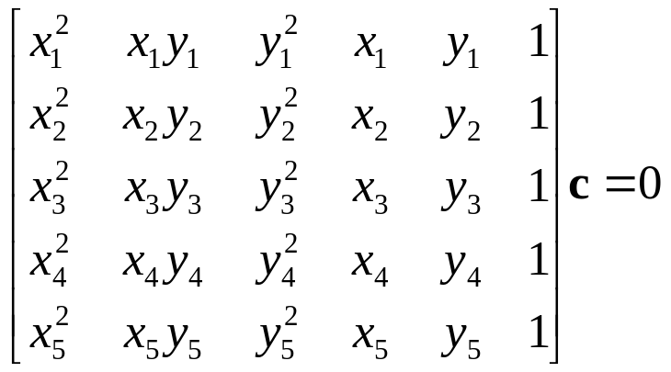
Five points define a conic
For each point the conic passes through
or
stacking constraints yields

Slide 15
Tangent lines to conics
The line l tangent to C at point x on C is given by l=Cx
l
x
C

Slide 16


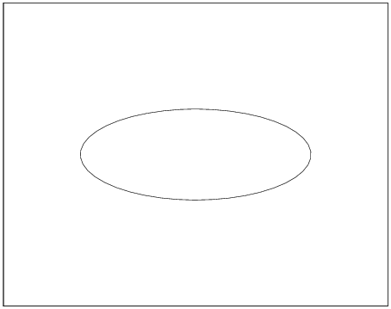
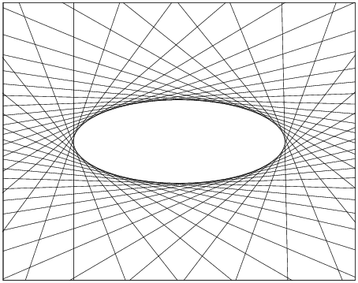
Dual conics
A line tangent to the conic C satisfies
In general (C full rank):
Dual conics = line conics = conic envelopes

Slide 17




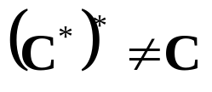
Degenerate conics
A conic is degenerate if matrix C is not full rank
e.g. two lines (rank 2)
e.g. repeated line (rank 1)
Degenerate line conics: 2 points (rank 2), double point (rank1)
Note that for degenerate conics

